Slide 1

Data Professionals Salary Analytics
Authored By:
Srikrishnan shankar

Slide 2
Table of Contents:
1. Introduction
2. Abstract of the Project
3. Tools or Softwares Used
4. Data Pre-Processing (Data Cleaning)
5. Data Analysis
6. Final Dashboard
7. Conclusion

Slide 3
1. Introduction
1. Analytics is the systematic computational analysis of data or statistics. It is used for the discovery, interpretation, and communication of meaningful patterns in data. It also entails applying data patterns toward effective decision-making. It can be valuable in areas rich with recorded information; analytics relies on the simultaneous application of statistics, computer programming, and operations research to quantify performance.
2. Organizations may apply analytics to business data to describe, predict, and improve business performance. Specifically, areas within analytics include predictive analytics, prescriptive analytics, enterprise decision management, descriptive analytics, cognitive analytics, Big Data Analytics, retail analytics, supply chain analytics, store assortment and stock-keeping unit optimization, marketing optimization and marketing mix modeling, web analytics, call analytics, speech analytics, sales force sizing and optimization, price and promotion modeling, predictive science, graph analytics, credit risk analysis, and fraud analytics. Since analytics can require extensive computation (see big data), the algorithms and software used for analytics harness the most current methods in computer science, statistics, and mathematics.
3. This Dataset consists of salaries for Data Scientists, Machine Learning Engineers, Data Analysts, and Data Engineers in various cities across India (2022).

Slide 4
2. Abstract of the Project
Perform Data Cleaning through Excel using Dax Functions.
Perform Data Analysis below mentioned through Excel and get some Insights from Dataset.
* Average Salary of Over-all Data Professionals.
* Average Salary by Location.
* Average Salary by Company.
* Average Salary by Job Title.
* Top Salary Reports by Company.

Slide 5
3. Tools / Softwares Used
The Tools used for the End-to-End process was EXCEL.

Slide 6
4. Data Cleaning
Data Cleaning is an Essential Part of the Data Analytics Project. Below have mentioned some points on Data Cleaning that were processed during this project.
1) Filtered Currency value in Salary Column, since it had few Values on Salary had on Dollars and Pounds, so we took them out from the Data.
3) Split Salary Column Based on Currency Value and Per(“/yr”, “/mo”, “/hr”).
4) Transformed Some Salary Currency value to make is Standardized according to “per year”.
5) Added a New Column called Domain Title and used as a Filter/Slicers in the Analysis and Dashboard.

Slide 7
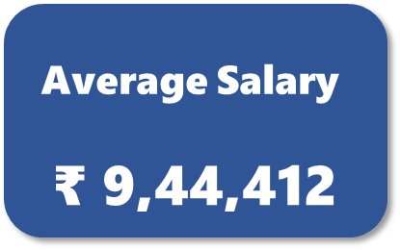
5. Data Analysis
1. Average Salary of Over-all Data Professionals.

Slide 8
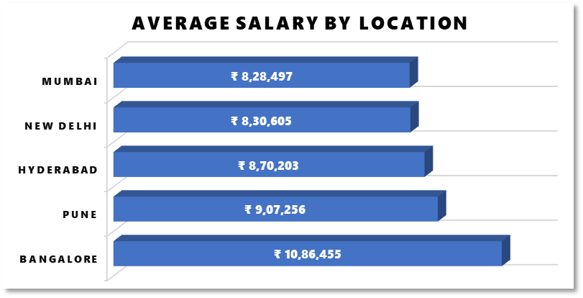
2. Average Salary by Location

Slide 9
3. Average Salary by Company

Slide 10
4. Average Salary by Job Title

Slide 11
5. Top Salary Reports by Company

Slide 12
6. Data Professional Filters

Slide 13
6. Final Dashboard

Slide 14
Conclusion
1) In Average Salary of Overall Data Professionals of rupees 9,44,412. Data Science Domain has the Highest Salary Package of rupees 11,75,497.
2) On Average Salary Package by Location Bangalore has Highest Package of rupees 10,86,455.
3) On Average Salary by Company “L Brands” provide Highest Package of rupees 1,88,07,948.
4) On Average Salary by Job Title, Data Science domain receives Highest Package up to rupees 46,19,021.
5) On Top Salary Reports by Company “Tata Consultant Service” is at top having reports up to 550.

Slide 15
Thank You Authored by: Name: Srikrishnan Shankar Email: srikrishnan214@gmail.com

